Slide 1
FRET Based HTS Assay Kit for SUMO1-UBC9 Interaction
David Bui
Randall Mello
Richard Lauhead
Michelle Tran

Slide 2
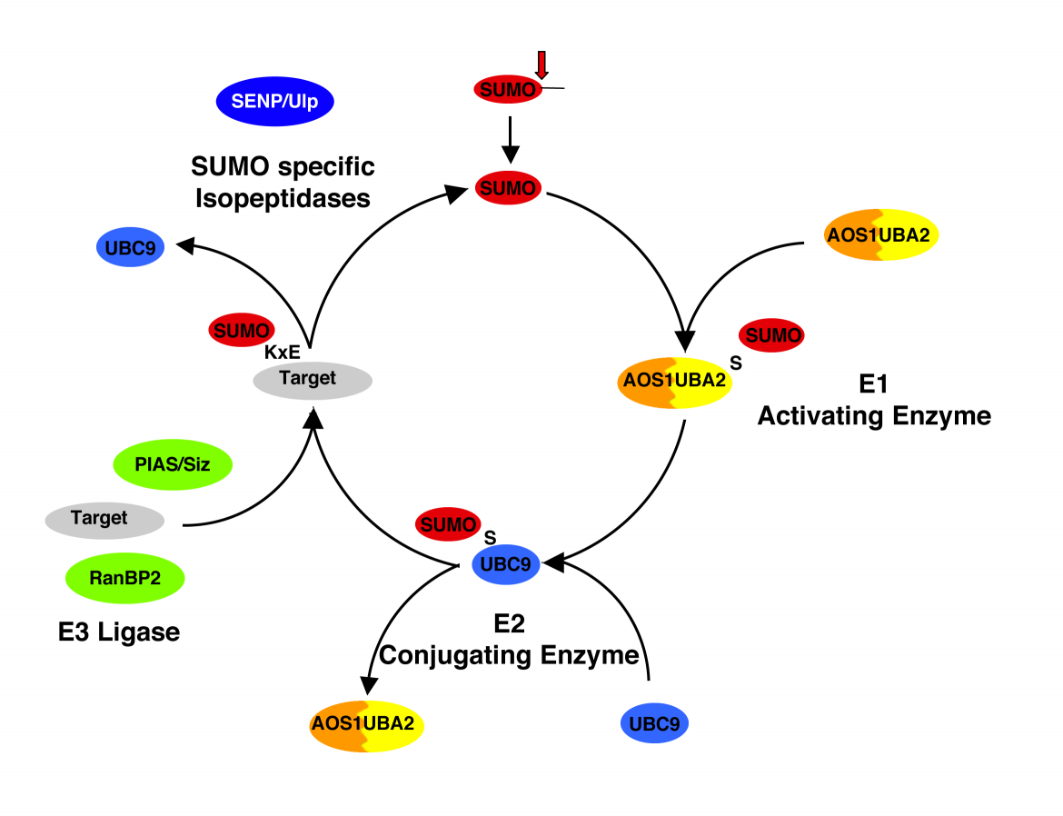
Introduction
Why is it important to have this kit?
  Disregulation of the SUMO pathway has been linked to diseases including ovarian carcinoma, melanoma, and lung adenocarcinoma. (Mo and Moschos 2005)
Goal: Development of FRET based kit to screen compounds that could alter binding between SUMO1 and UBC9.
http://www.biochem.mpg.de/jentsch/Mueller.html

Slide 3
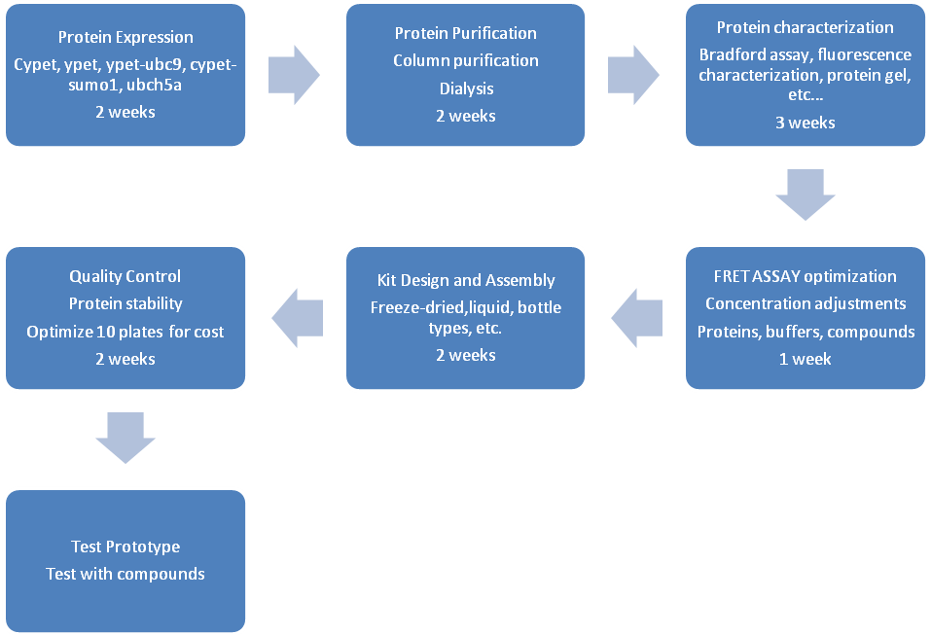
Project Flow Chart

Slide 4
Sensitivity of Flexstation II
Using highly pure proteins, serial dilutions were done to make solutions at different protein concentrations
Values range from
1 ng to 100 µg of protein per well

Slide 5
Sensitivity of Flexstation II
- A general HTS development instrument
For accurate fluorescence measurements of single proteins and conjugations, an assay must have values away from background noise
500 ng is the lowest amount for usable assay conditions.
Ypet-Ubc9 (ng) | RFU without blank | RFU without blank | RFU without blank
100000 | 58734866.98 | 55943707.39 | 61961881.18
50000 | 36425642.98 | 36053579.39 | 39276933.18
25000 | 20232692.98 | 20081895.39 | 23343669.18
10000 | 7194076.48 | 7613824.887 | 9610900.176
5000 | 4313948.98 | 3672442.637 | 4147272.676
2500 | 1905796.605 | 1675790.887 | 1826577.176
1000 | 432355.386 | 416138.231 | 433805.832
500 | 118134.269 | 199872.325 | 247566.004
100 | 8604.365 | 15551.569 | 13429.223
50 | 2701.488 | 17229.912 | 11205.072
25 | 371.426 | 3043.334 | 8485.249
10 | -1422.633 | -372.635 | 3125.487
5 | -1634.192 | 1552.071 | 1672.986
2.5 | -1682.931 | 2221.778 | 2313.75
1 | -1428.963 | -136.699 | 965.361
0 | 0 | 0 | 0
Cypet-Sumo1 (ng) | RFU without blank | RFU without blank | RFU without blank
91500 | 22667111.59 | 23441949.39 | 23460794.73
50000 | 9461644.594 | 13937961.39 | 15112699.73
25000 | 5334212.594 | 8311063.387 | 9603005.729
10000 | 2223233.344 | 2547688.137 | 4388946.729
5000 | 1010283.219 | 1294915.387 | 2053190.604
2500 | 493361.313 | 681590.324 | 730195.979
1000 | 135762.875 | 196490.34 | 217703.057
500 | 58105.11 | 72562.403 | 69732.471
100 | 6996.274 | 6824.616 | 7213.549
50 | 1396.175 | 7010.968 | 3055.906
25 | 5140.756 | 3566.683 | 773.441
10 | -1246.045 | 2060.112 | 739.592
5 | -1626.112 | 3063.877 | 168.947
2.5 | -1058.78 | 2058.266 | 429.742
1 | -465.929 | 13409.479 | -50.309
0 | 0 | 0 | 0

Slide 6
Purification Optimization using Ni-His Purification
Cell Lysate obtained from 1 Liter of E. coli solution and resuspended in 30 mL of Resuspension buffer
Column purification protocol involves 10mL of lysate poured into a column with 500 µL of agarose nickel bead solution with subsequent 10 mL washes.
Elution took place 500 µL at a time and continued until the beads showed no fluorescence.
Resuspension Buffer | Concentration(M)
NaCl | 0.5
Tris-HCl pH 7.4 | 0.2
Immidazole | 0.005
Ingredients | Concentration of Solutions(M)
Wash1 | Protocol 1 | Protocol 2 | Protocol 3
NaCL | 0.3 | 0.5 | 0.4
Tris HCL pH 7.4 | 0.02 | 0.02 | 0.02
Wash2
NaCL | 0.3 | 2 | 1.2
Tris HCL pH 7.4 | 0.2 | 0.02 | 0.02
Triton | 0.50% | 2.00% | 1.25%
Wash3
NaCL | 0.3 | 2 | 1.2
Tris HCL pH 7.4 | 0.2 | 0.02 | 0.02
Immidazole | 0.02 | 0.05 | 0.035
Elution
NaCL | 0.3 | 0.3 | 0.3
Tris HCL pH 7.4 | 0.02 | 0.02 | 0.02
Immidazole | 0.15 | 0.25 | 0.2
Wash solutions adapted from Qiagen Ni-NTA agarose beads purification booklet

Slide 7
Method to Determine Protein Concentration
Bradford Assay:
Total protein concentrations of solution can be calculated using the equation obtained from graph.

Slide 8
Purification Optimization using Ni-His Purification
Using the Bradford Assay to determine total protein concentration and the fluorescence curves generated from the sensitivity tests, the purity was calculated for each protocol
Ypet-UBC9
Purification protocol | Bradford concentrations(ng/uL) | fluorescent concentration (ng/uL) | Purity
Protocol1 | 7710 | 5086.89 | 0.66
Protocol2 | 955 | 617.27 | 0.65
Protocol3 | 5500 | 2783.92 | 0.51
Cypet-SUMO1
Purification protocol | Bradford concentrations(ng/uL) | fluorescent concentration (ng/uL) | Purity
Protocol1 | 4844.94 | 4708.36 | 0.97
Protocol2 | 3191.38 | 1678.81 | 0.53
Protocol3 | 4642.16 | 3229.12 | 0.70

Slide 9
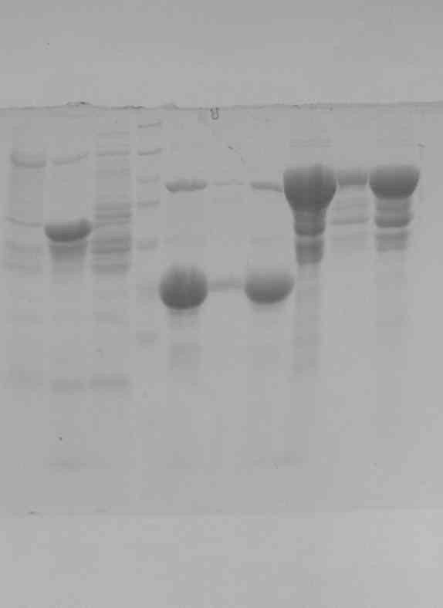
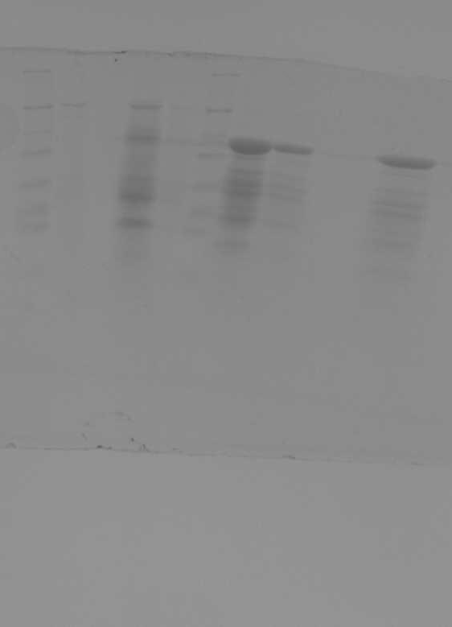
Purification Optimization using Ni-His Purification
Ypet-UBC9
Cypet-SUMO1
Ypet-UBC9 could be around 70% pure
Cypet-SUMO1 is unlikely to be 97% pure
Prot.1
Prot.2
Prot.3
Prot.1
Prot.2
Prot.3

Slide 10
Purity effects on fluorescence
Keeping a constant fluorescent protein amount at 1 µg.
BL21 cell lysate proteins were added to change percent purity.
Results show that purity has little effect on fluorescence at 1µg of fluorescent protein.
Other Proteins do not interfere with fluorescent intensity

Slide 11
Purity effects on FRET
Tested purity effects on FRET with each protein at a constant amount of 500 ng.
Results demonstrate that purity of fluorescent proteins and in FRET has no effect at low concentration(10ng/µl).
Emission max of Ypet-Ubc9 over Cypet-SUMO1 to obtain FRET ratio.
Results demonstrate little to no change in FRET ratio when purity is varied.
Purity does not have significant effect on FRET ratio

Slide 12
Lyophilization Effects
Experimental Design
  Lyophilize 1mL of protein solution in 1.5mL tubes for Cypet-SUMO1 and Ypet-UBC9 for the following tests
    Lyophilized and stored as powder at RT
    Lyophilized and stored as powder at 4 degree
    Lyophilized and stored as powder at -20 degree
    Lyophilized and stored as powder at -80 degree
    Lyophilized then stored as solution at RT
    Lyophilized then stored as solution at 4 degree
    Lyophilized then stored as solution -20 degree
    Lyophilized then stored as solution -80 degree

Slide 13
Lyophilization Effects
Obtained purity before lyophilization
Weighed tube before and after lyophilization to obtain protein amount and fluorescent protein amounts
Diluted all solutions to have the same protein concentrations, and same total protein amount per well.
Performed FRET analysis of each solution to determine FRET effeciency

Slide 14
Lyophilization Effects

Slide 15
Lyophilization Effects

Slide 16
Gantt Chart
SUMO ASSAY KIT
 |  |  |  | 1/18/2010 |  |  |  | 1/25/2010 |  |  |  | 2/1/2010 |  |  |  | 2/8/2010 |  |  |  | 2/15/2010 |  |  |  | 2/22/2010 |  |  |  | 3/1/2010 |  |  |  | 3/8/2010 |  |  |  | 3/15/2010 |  |  |  | 3/22/2010 |  |  |  | 3/29/2010 |  |  |  | 4/5/2010 |  |  |  | 4/12/2010 |  |  |  | 4/19/2010 |  |  |  | 4/26/2010 |  |  |  | 5/3/2010 |  |  |  | 5/10/2010 |  |  |  | 5/17/2010 |  |  |  | 5/24/2010 |  |  |  | 5/31/2010 |  |  |  | 6/7/2010
Tasks | Start | End | %complete
Purification optimization | 1/18/2010 | 2/8/2010 | 100%
Flexstation 2 fluorescence sensitivity test | 1/18/2010 | 2/8/2010 | 100%
Dialysis/Lyophilization | 2/1/2010 | 2/22/2010 | 100%
Protein purity effects | 2/1/2010 | 2/22/2010 | 50%
Expression optimization | 3/1/2010 | 3/15/2010
Fret sensitivity | 3/1/2010 | 3/15/2010 | 10%
compound screening sensitivity | 3/22/2010 | 4/5/2010
Stability testing | 3/22/2010 | 4/5/2010 | 10%
Oxidation testing | 4/12/2010 | 4/26/2010
Kit assembly | 4/12/2010 | 4/26/2010
Add secretion factors to proteins | 5/3/2010 | 5/31/2010

Slide 17
Questions?

